Slide 1
OpenDSS Training Workshop
Basics and Scripting
Andres Ovalle
EPRI Knoxville, TN
August 30, 2021

Slide 2

Instructor
Andres Ovalle
Andres is …

Slide 3
Installation and Startup
Installation and basic usage

Slide 4
Accessing the SourceForge.Net Source Code Repository with TortoiseSVN
Install a TortoiseSVN client from Tortoisesvn.net/downloads.
Recommendation:
Then, to grab the files from SourceForge by: 1 - create a clean directory such as "c:\opendss" 2 - right-click on it and choose "SVN Checkout..." from the menu 3 - the repository URL is
http://electricdss.svn.sourceforge.net/svnroot/electricdss
(Change the checkout directory if it points somewhere other than what you want.)
Thereafter, to update a folder or file, right-click on the folder or file and select SVN Update

Slide 5
Program Installation

Slide 6
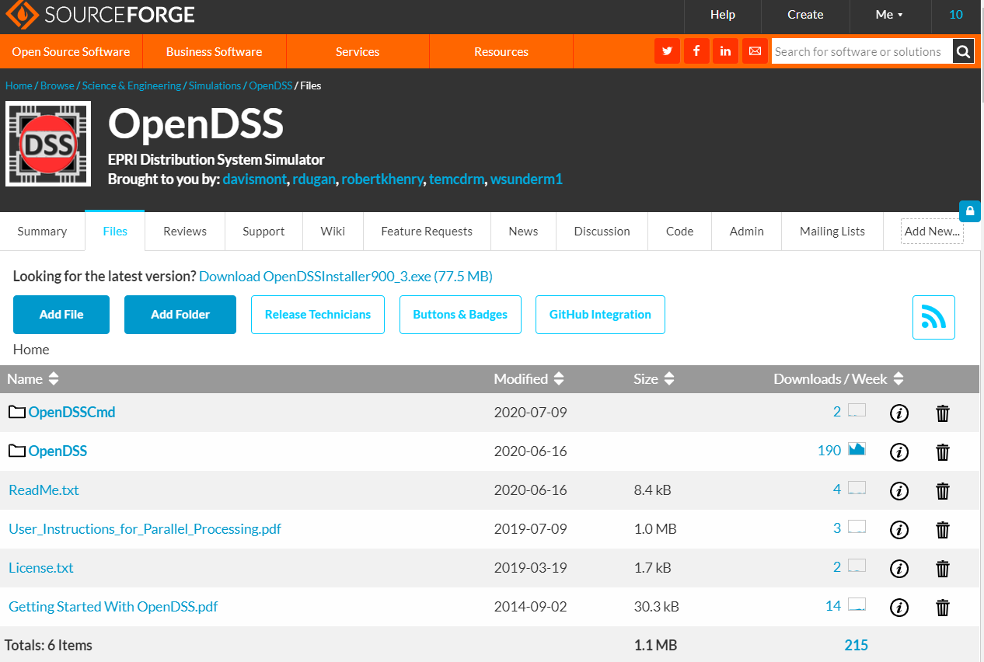
Download the Installer Files

Slide 7
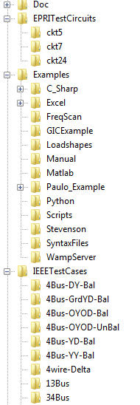
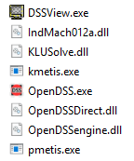
OpenDSS Files Installed
Main Program Files

Slide 8
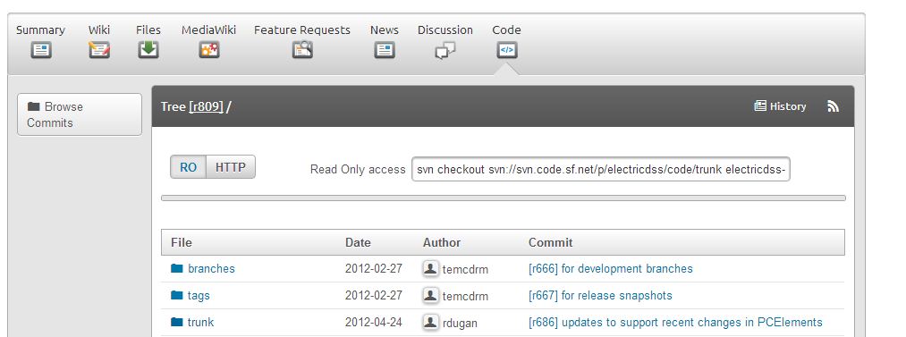
SourceForge.Net Links for OpenDSS
EPRI Links Page
https://www.epri.com/#/pages/sa/opendss?lang=en-US
OpenDSS Download Files:
http://sourceforge.net/projects/electricdss/files/
Top level of Main Repository

Slide 9
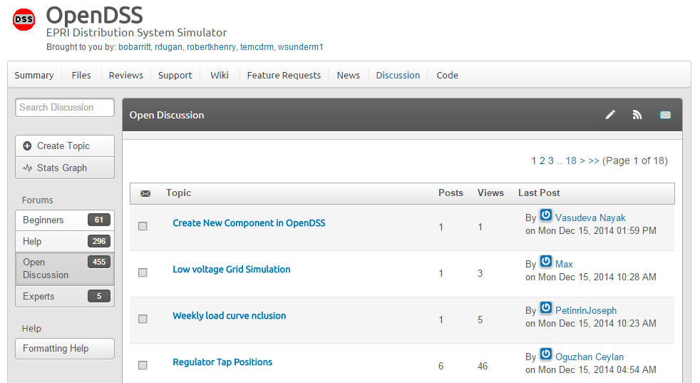
Discussion Forum & News for OpenDSS

Slide 10
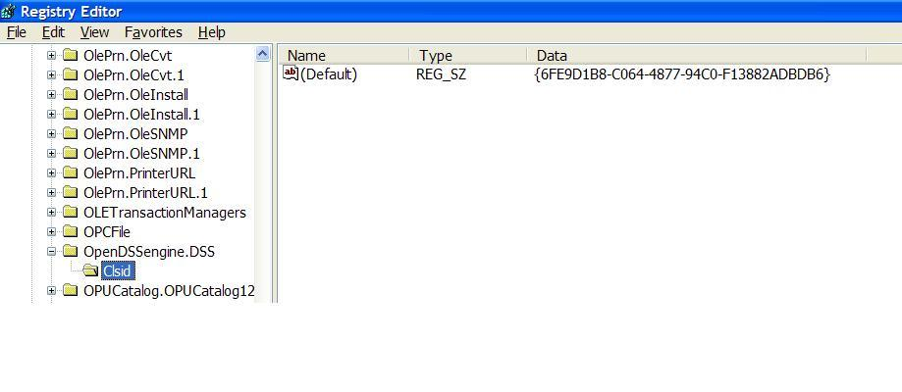
COM Server Registration
Windows Registry Entry
GUID
The Server shows up as “OpenDSSEngine.DSS” in the Windows Registry
The OpenDSS is now available to any program on the computer

Slide 11
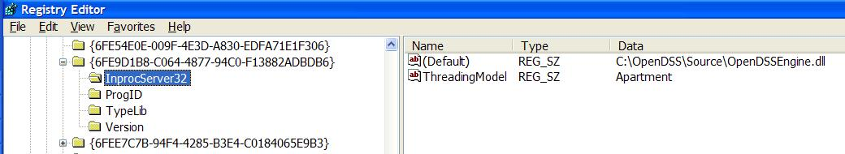
The GUID References the DLL File ….
If you look up the GUID in RegEdit
Points to OpenDSSEngine.DLL (In-process server, Apartment Threading model)

Slide 12
Accessing the SourceForge.Net Source Code Repository with TortoiseSVN
Install a TortoiseSVN client from Tortoisesvn.net/downloads.
Recommendation:
Then, to grab the files from SourceForge by: 1 - create a clean directory such as "c:\opendss" 2 - right-click on it and choose "SVN Checkout..." from the menu 3 - the repository URL is
http://electricdss.svn.sourceforge.net/svnroot/electricdss
(Change the checkout directory if it points somewhere other than what you want.)
Thereafter, to update a folder or file, right-click on the folder or file and select SVN Update

Slide 13
Starting the Program
.

Slide 14
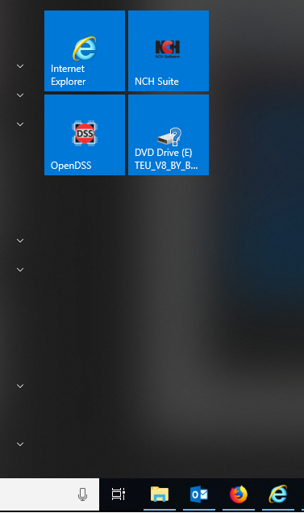

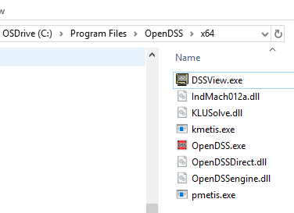
Starting OpenDSS.exe – Standalone executable
Start Menu
Desktop Icon
File Manager/Explorer

Slide 15
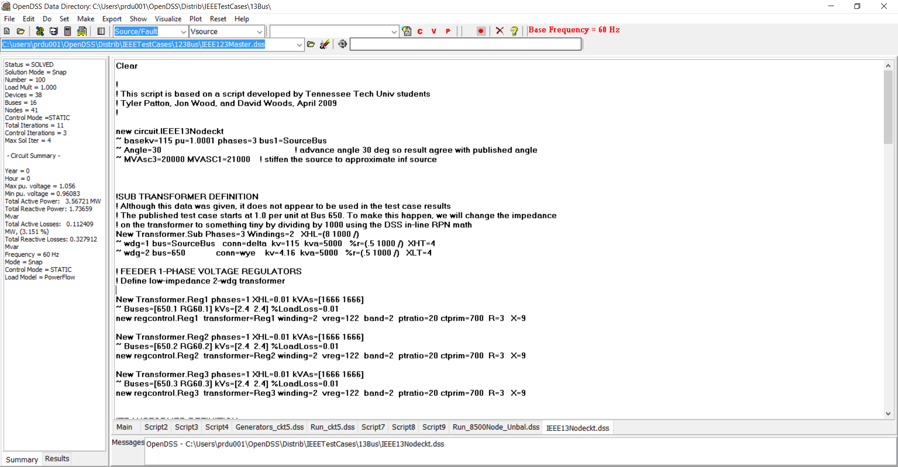
Basic User Text Script Screen
Home Folder
Circuit Script
Solution Summary
File Displayed

Slide 16
(Live Demo)
.

Slide 17
Questions ??

